Slide 1
Finding the Difference Between Casual Riders and Member Riders
Cyclistic
July 5

Slide 2
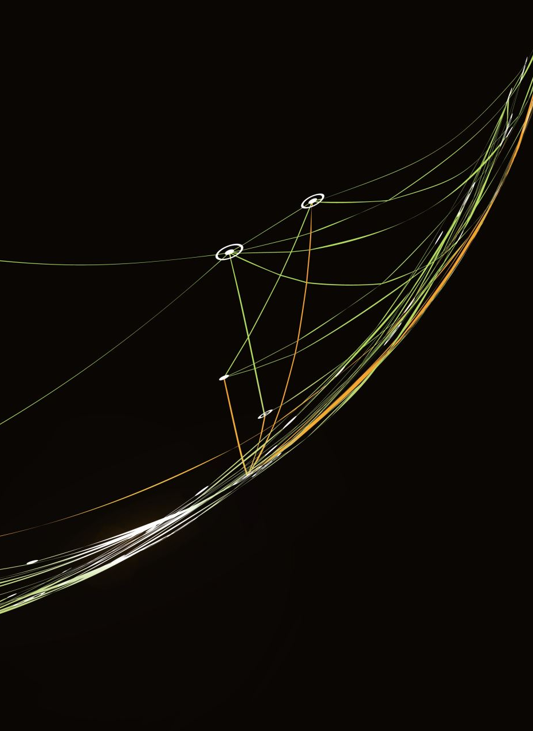
Agenda
Introduction (4min)
Project Overview and Goals (5 min)
Data Analysis (10 min)
Recommendations (3 min)
Actionable Steps (3 min)

Slide 3
Purpose
Member riders bring more profit compared to casual riders. The aim of this project was to determine what is the difference between casual and member riders.

Slide 4
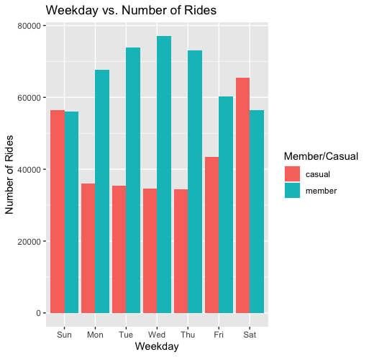
The number of rides per member is greater than casual members during the weekday.
There seems to be a minimal difference during the weekend.
Notes:
Casual members are in blue and members are in red
X axis is the weekday and y axis is the number of rides per day
We can see how there is a slight increase in the number of rides in casual riders as the weekday approaches Saturday
We can see how the number of rides for member riders increases from Monday and reaches a peak on Wednesday and then begins decreasing until sunday

Slide 5
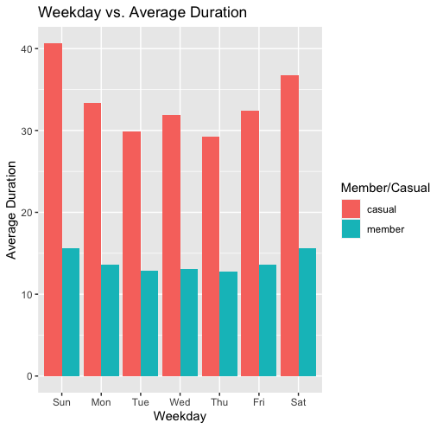
Casual riders have a significant difference compared to member riders
Notes:
On the x axis we have the weekday and on the y axis we have the average duration per day
We have casual riders in red and members in blue

Slide 6
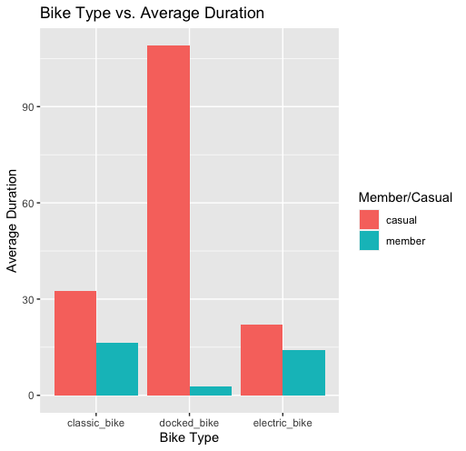
Casual riders have a high average duration for docked_bikes
Member riders have a low average duration for docked bikes

Slide 7
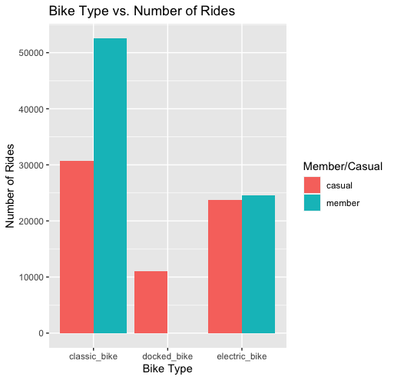
There is a greater amount of member riders in classical bikes
There is no number of member riders for docked bikes

Slide 8
The amount of casual riders gradually increases reaching its peak on a Saturday.
The amount of member riders is at all time high during the weekday and decreases during the weekend.
The difference that seems to be prevalent between casual and member riders is that casual members spend more time using the bikes.
Casual members use docked bikes more often.

Slide 9
What I recommend to do is figure out why docked bikes are being used more and conduct statistical analysis to discover if there is any correlation between riders and rideable type.
While also giving some form of a benefit for riding longer while being a member

Slide 10

Questions

